Slide 1
Measuring Cooling Loads
Case Study- Bell

Slide 2
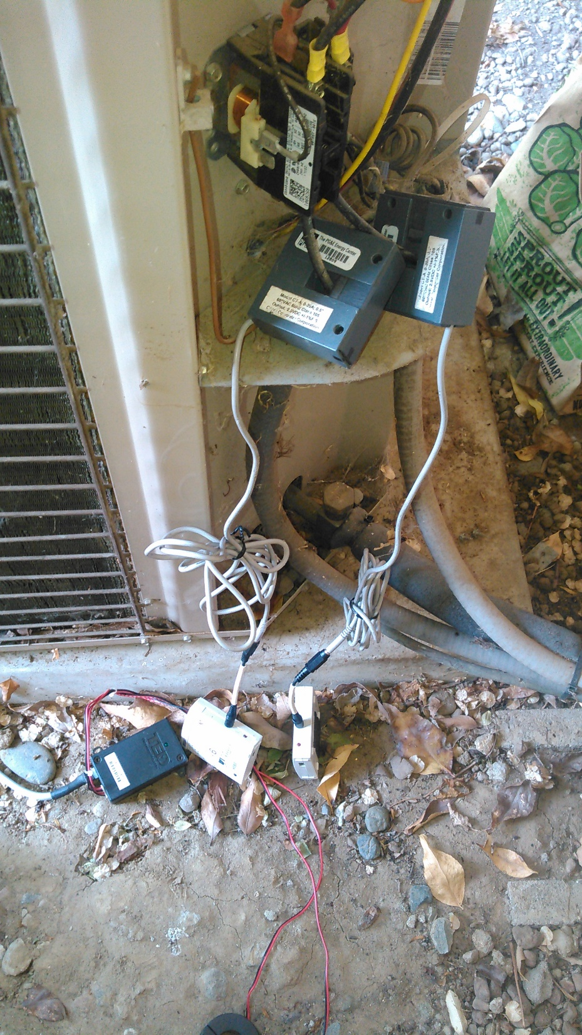
Before we get started
How do we define the home’s cooling load?
How do we model the home’s cooling load?
How do we measure the home’s cooling load?

Slide 3
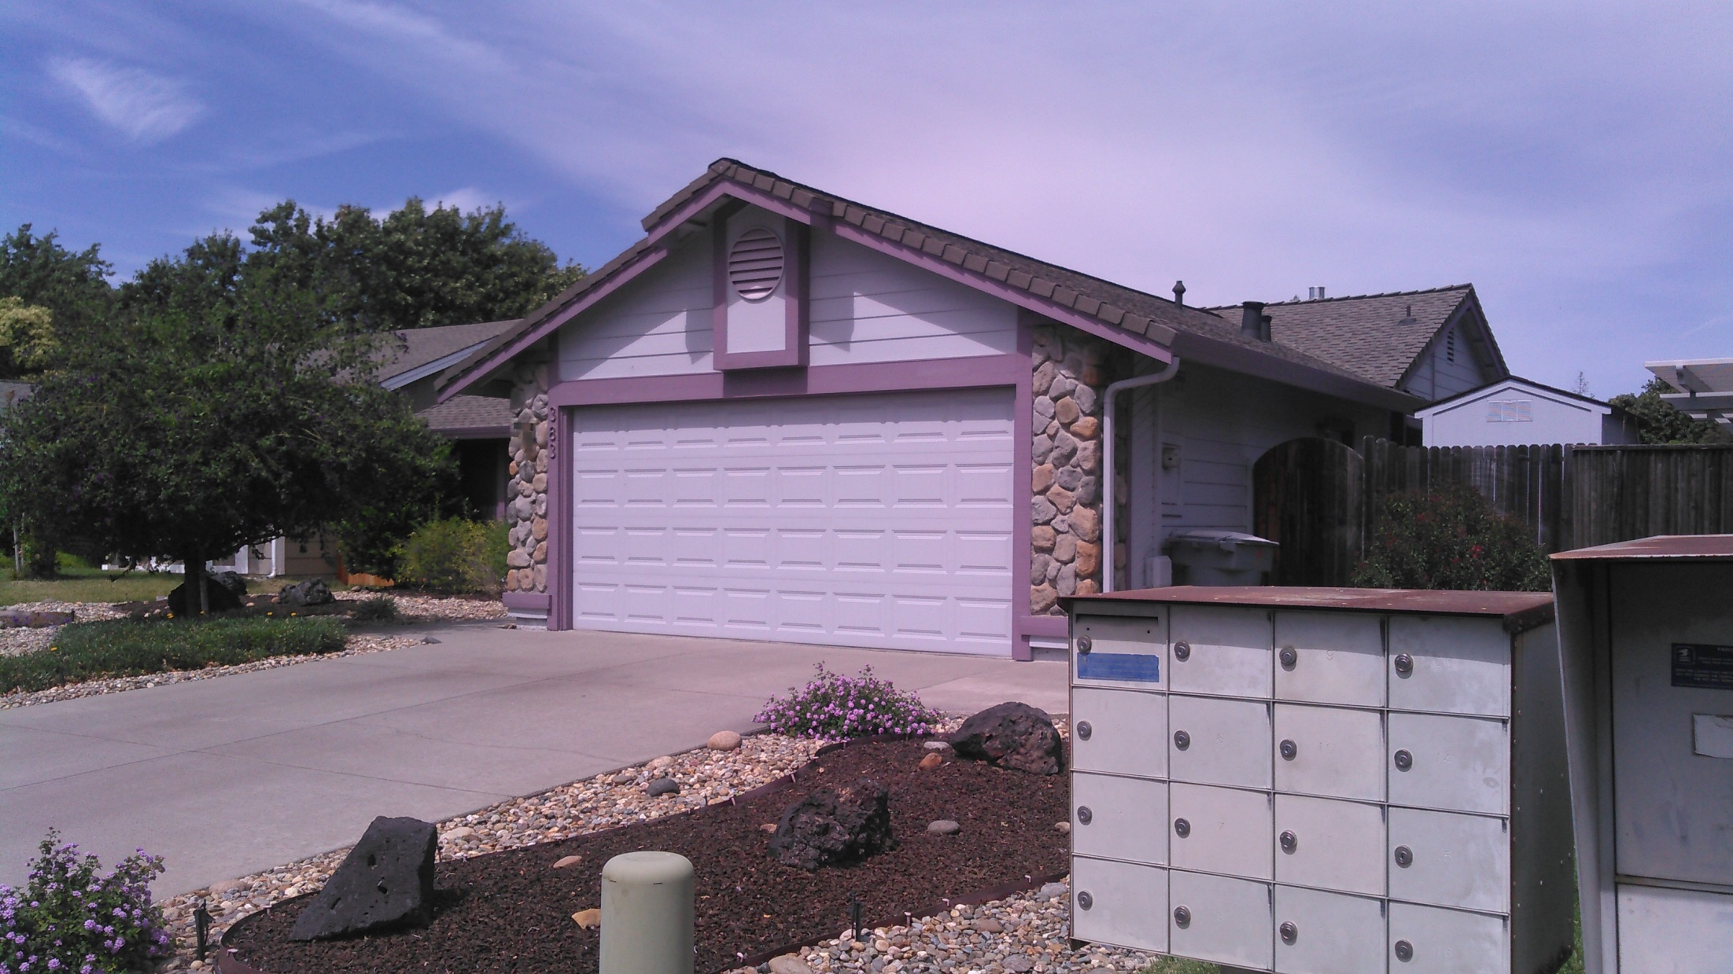
Vacaville- Nut Tree Area- Karen Bell

Slide 4
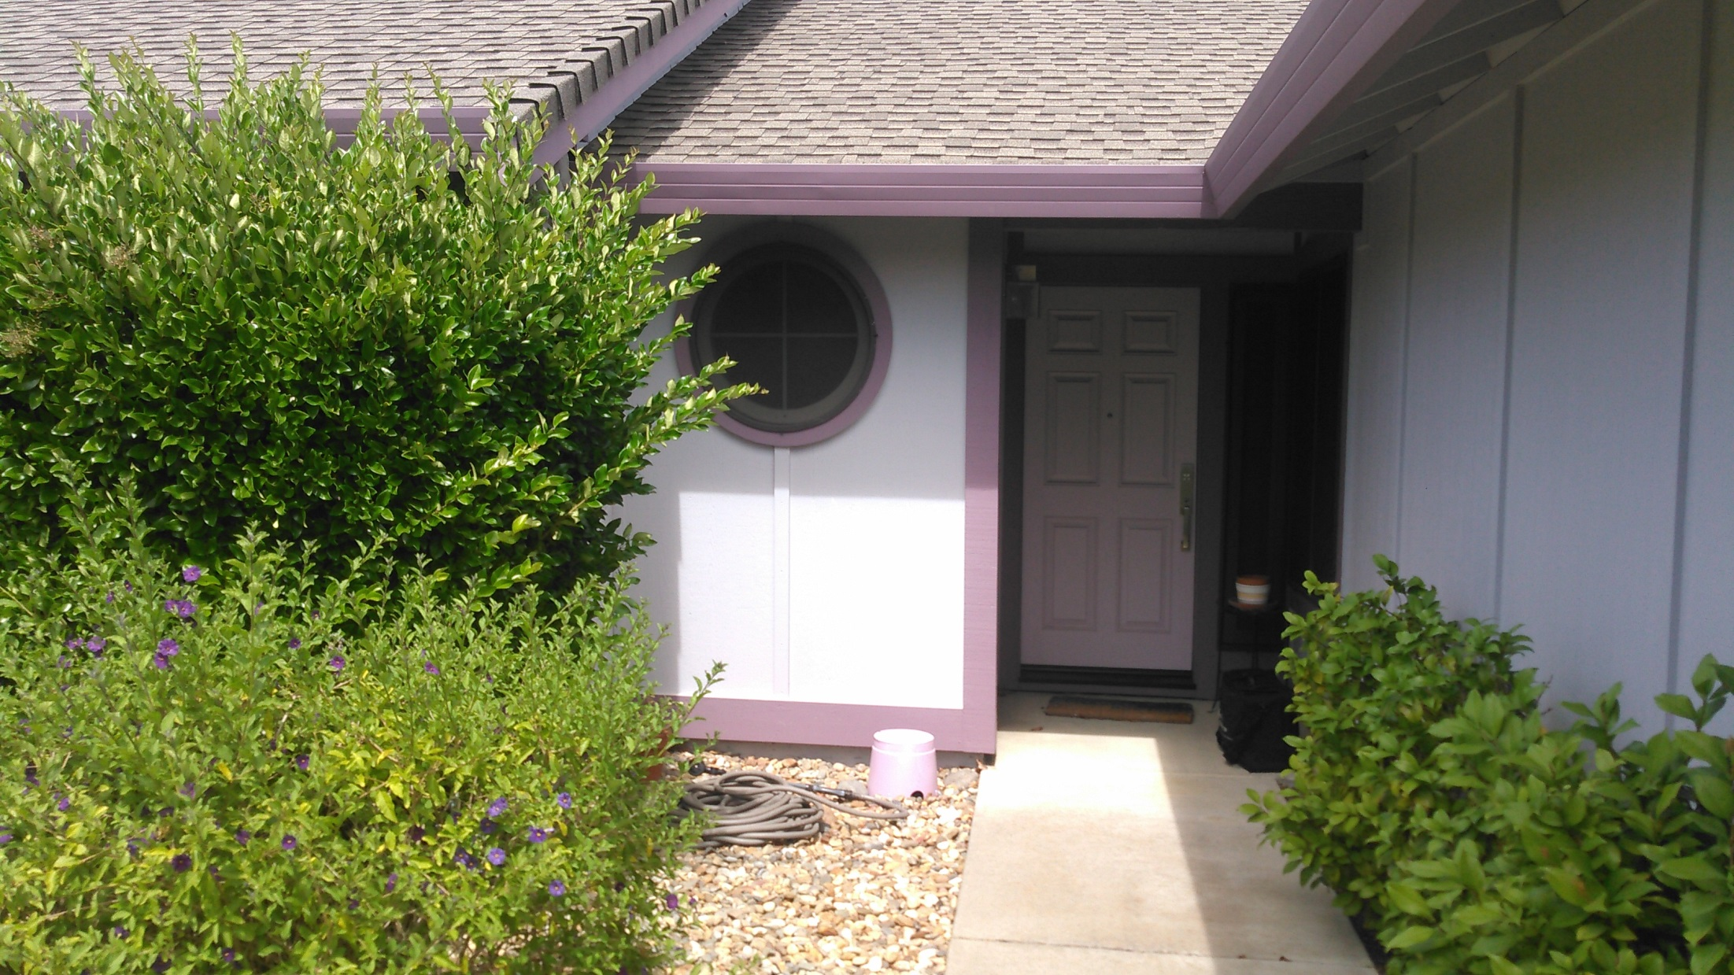

Slide 5
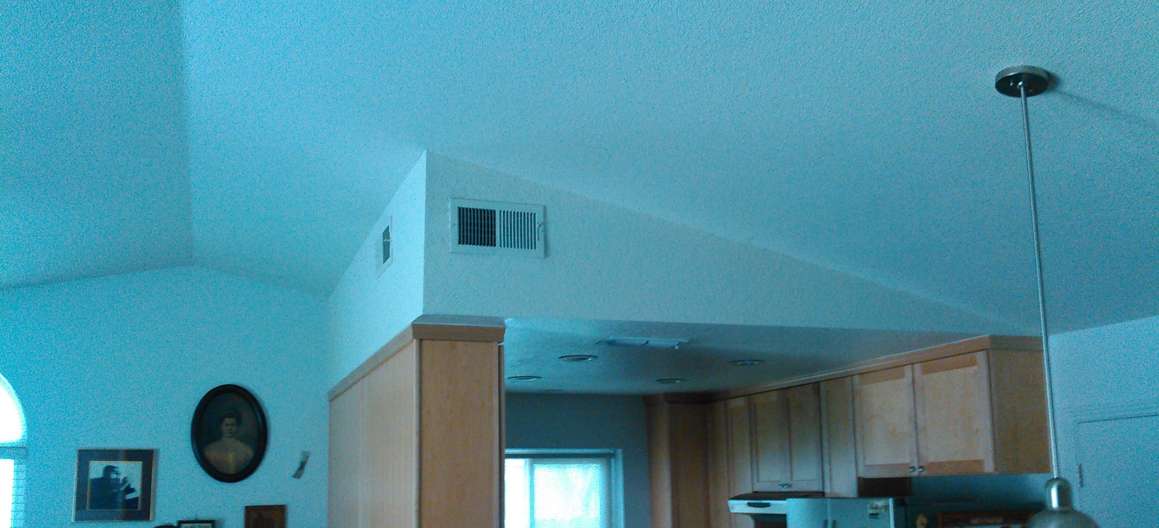

Slide 6
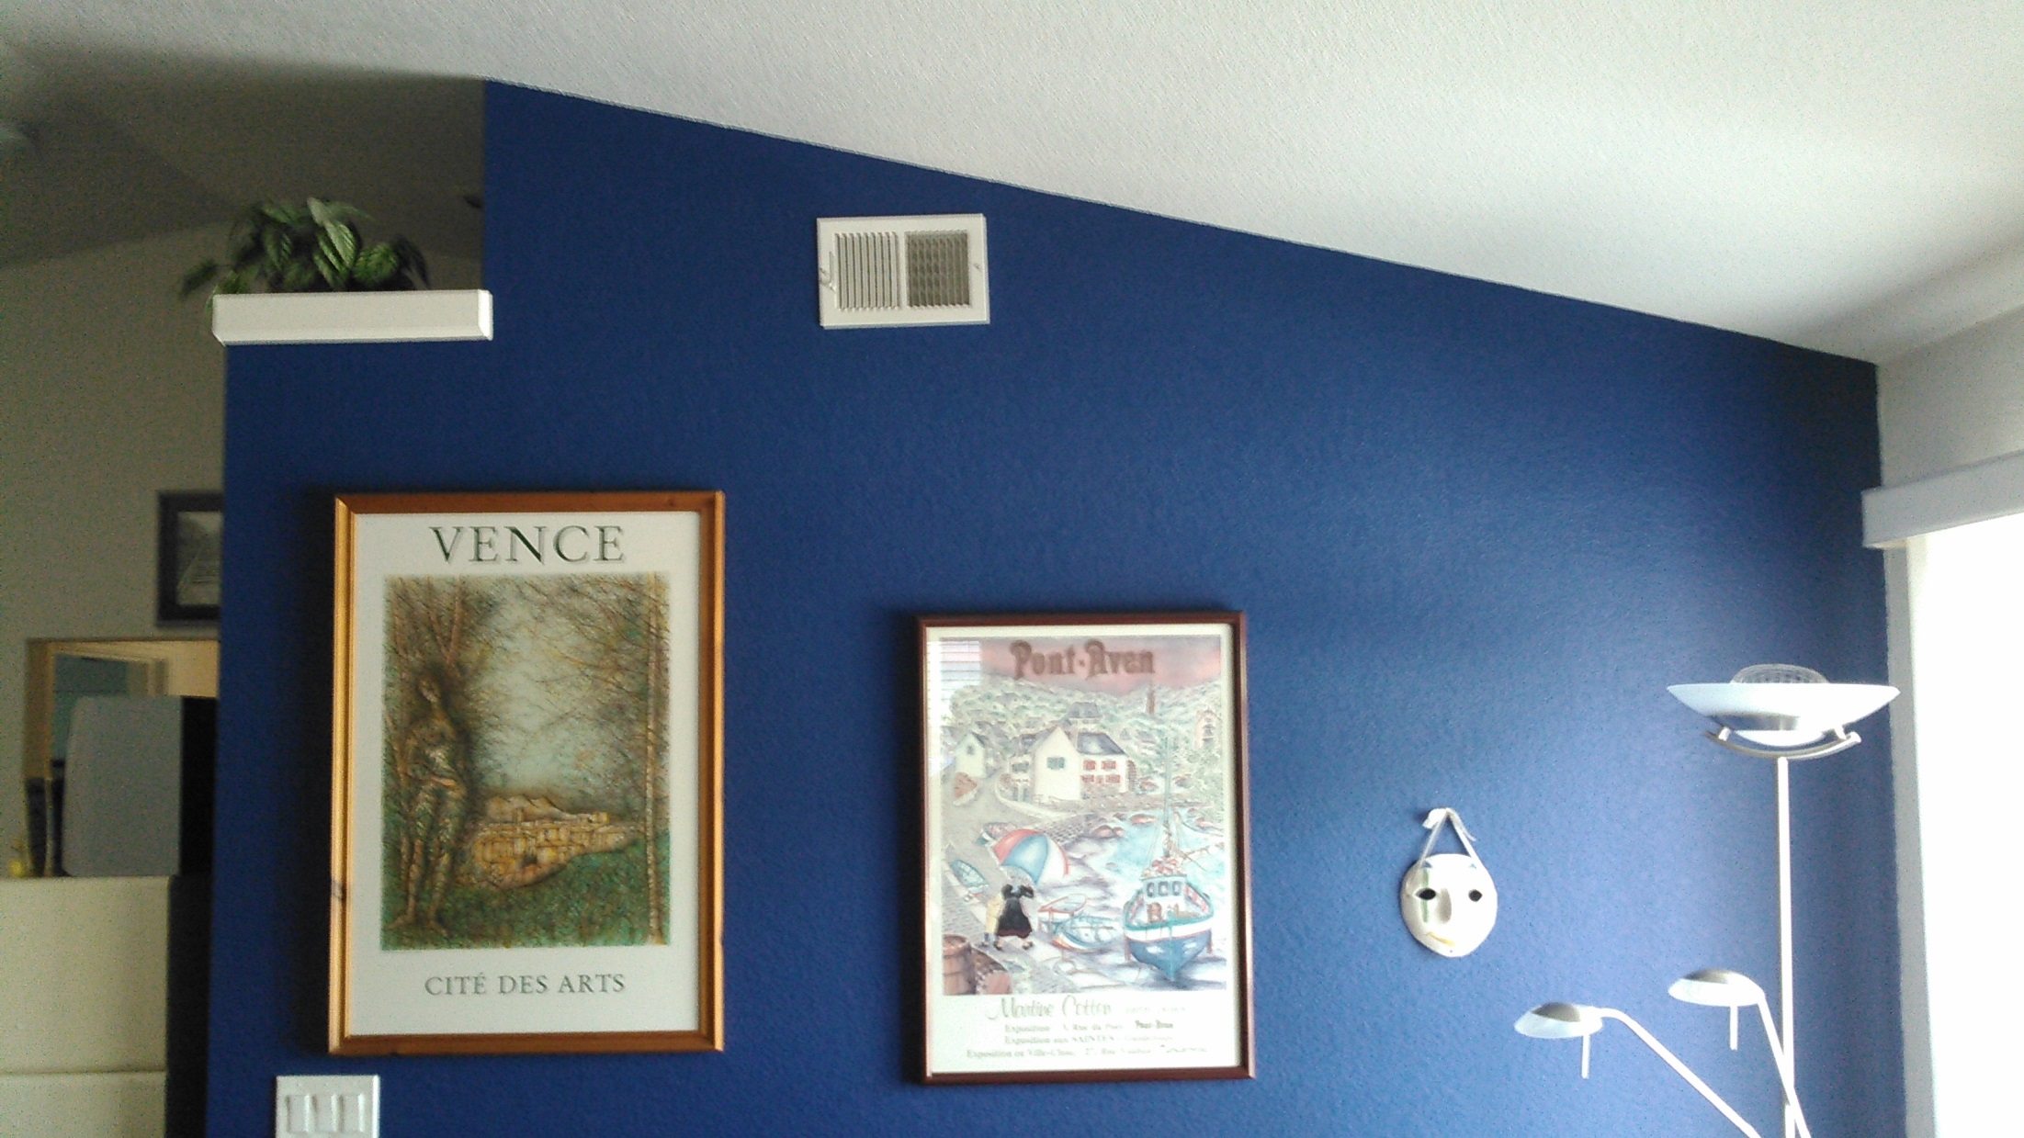

Slide 7
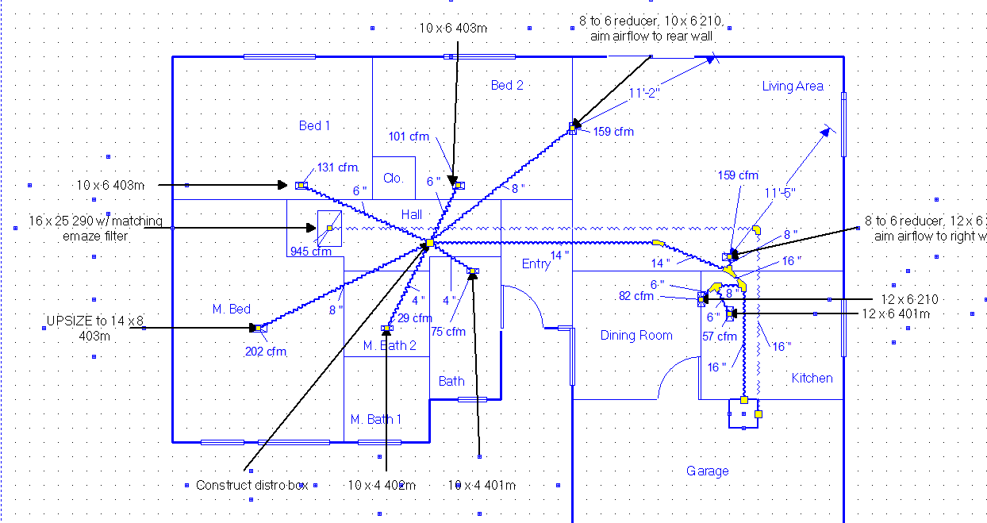

Slide 8
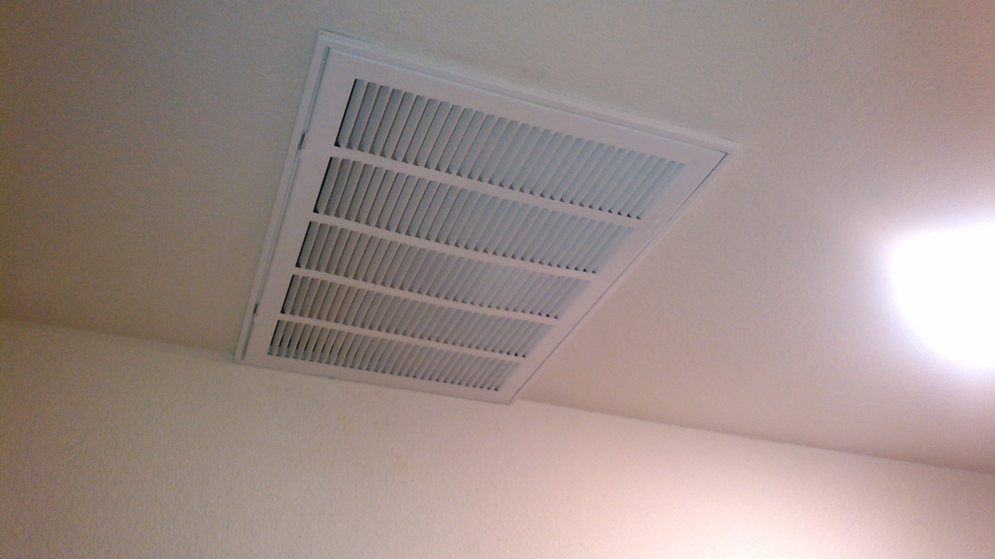
16” return duct

Slide 9
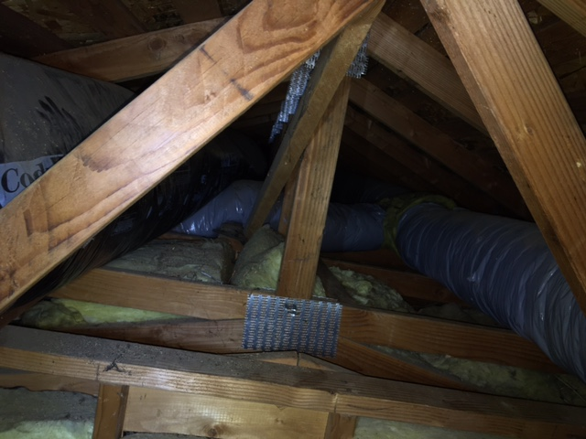

Slide 10
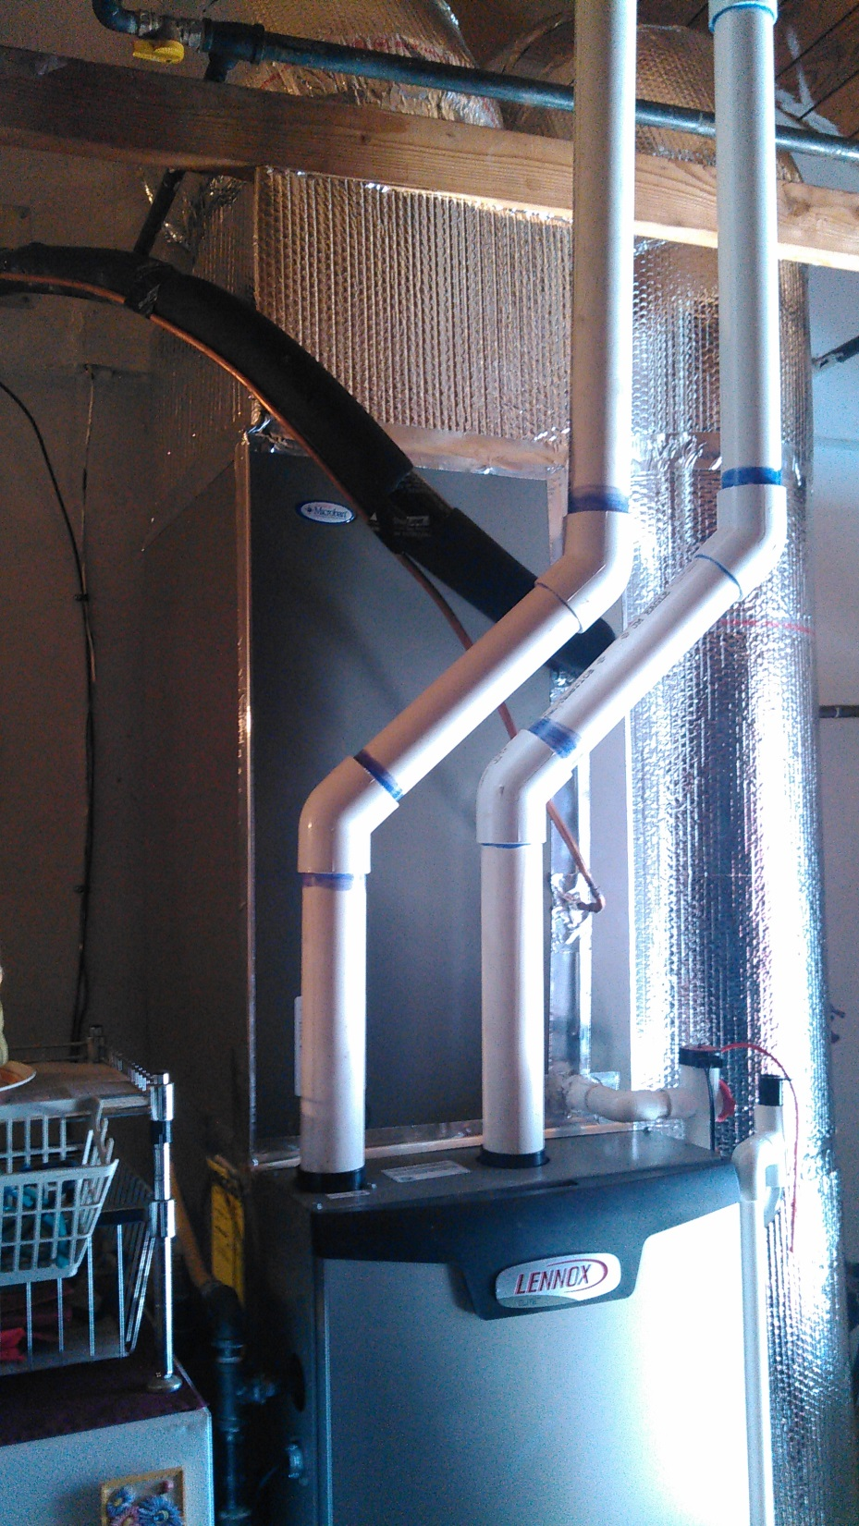

Slide 11
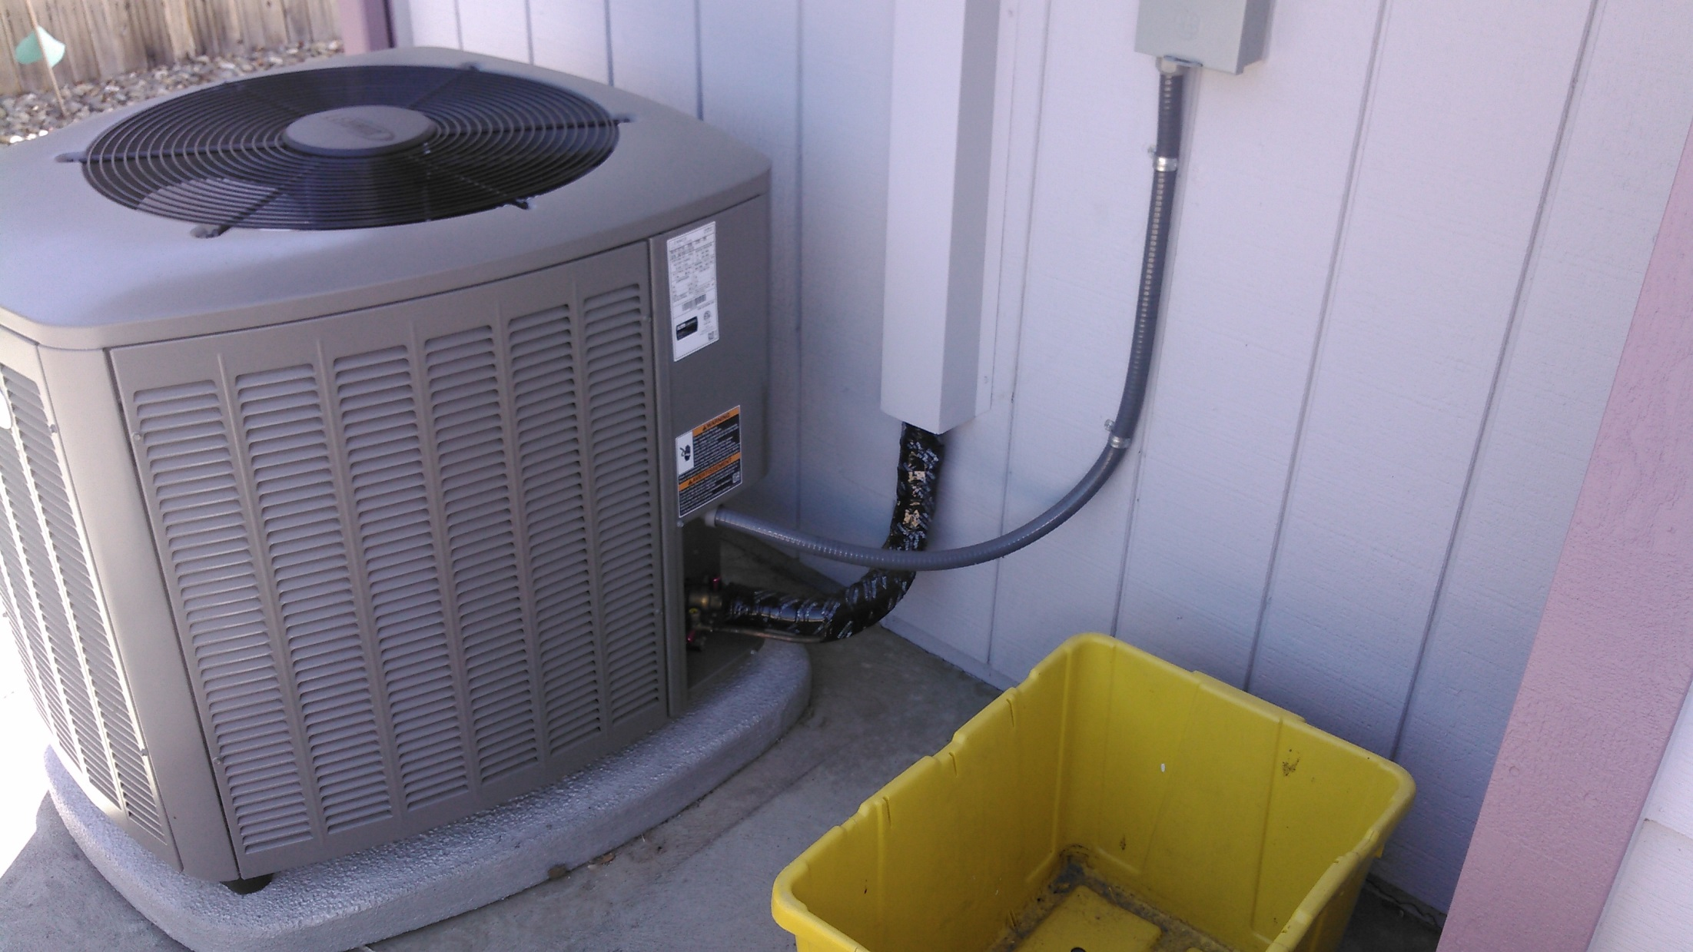

Slide 12
House Deets
1200 SQFT
3 bedrooms with single occupant
Front is west facing with dual pane windows w/ shutters closed and some shading
Built in 1989.
New R-6 ductwork at 124 CFM25 duct leakage
1500 CFM50
System Operation: Set at 78 degrees, “on at 2”
Question: What’s the cooling load?
(Hint: model says it’s about 18 kBTUh @ 78 IAT)

Slide 13
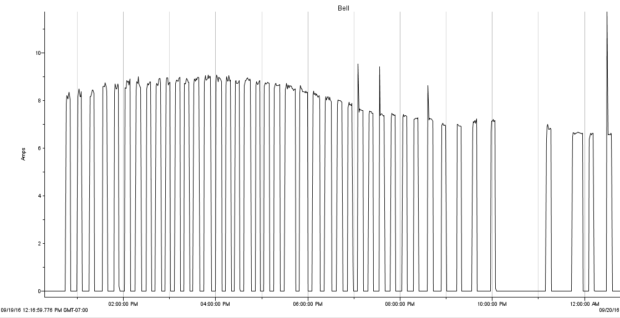
9/19- Max Temp of 100 degrees- 15th hottest day of 2016
42 cycles, average length 7.3 minutes

Slide 14
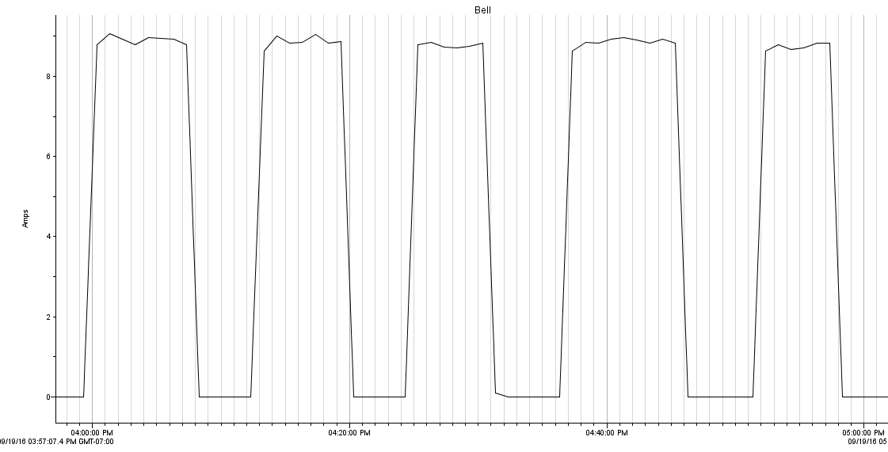
Runtimes at OAT of 98°F, 4 PM to 5 PM
8
8
7
10
7
Ran for 40 minutes or 2/3 of an hour

Slide 15
Calculating the Cooling Load
Ran for 2/3 hour in low stage (measured)
Low-stage system capacity of 21.42 kBTUh
2/3 of an hour * 21.42 kBTUh = 14.28 kBTU or 1.2 tons.
At design temperatures, the home’s measured cooling load is 14.28 kBTUh.
This is 15% lower than load calculation and a ton-and-a-half lower than the installed system capacity.

Slide 16
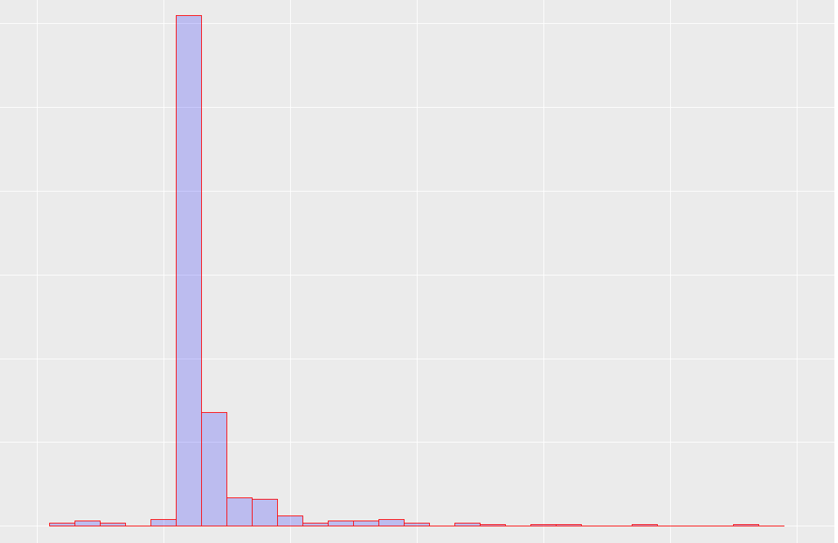
Distribution of Runtimes
Histogram of Runtimes
300
Average Runtime: 6 minutes
Longest Runtime: 28 minutes
Total Runtime of 50 hours
Low Stage 49.5 min./ High Stage 0.5 hours
Energy Used: 229 kWh
Operating Cost: $50
200
100
0
10
20
Minutes

Slide 17
End Presentation

Slide 18
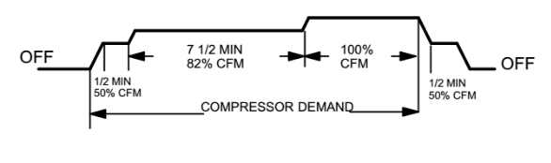
iComfort Options for Staging/Efficiency
Smooth Setback Recovery- Enabled/Disabled?
Algorithm looks to meet programmed temperature in 2 hours. So it effectively kicks on the system earlier.
Staged Delay Timer- Enabled/Disabled?
2nd stage will be activated if system does not advance the ambient temperature toward the set-point by 1° in X minutes. (5-120 minutes)
1st Stage Temp Differential?- 0.5° to 3° (default 1°)
2nd Stage Temp Differential?- 0.5° to 8° (default 1°)
Each stage differential is based on previous stage differential endpoint.
Airflow Profile?

Slide 19
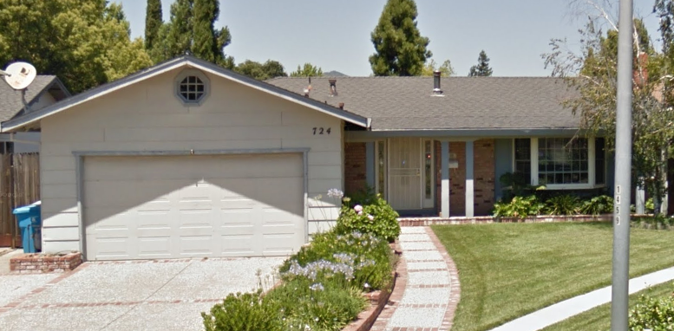
Brick- 724 Corte Crestview

Slide 20
House Deets
3 ton 14 ACX w/ 45 kBTU FAU in mech closet
1560 SQFT (zillow), built 1973
Newer house, 113 CFM25 TDL, 3622 CFM50
Dual pane windows with some shading
Monitored run times in 3 minute intervals from 7/6 to 10/1
Thermostat at 78 degrees, “set and forget”

Slide 21
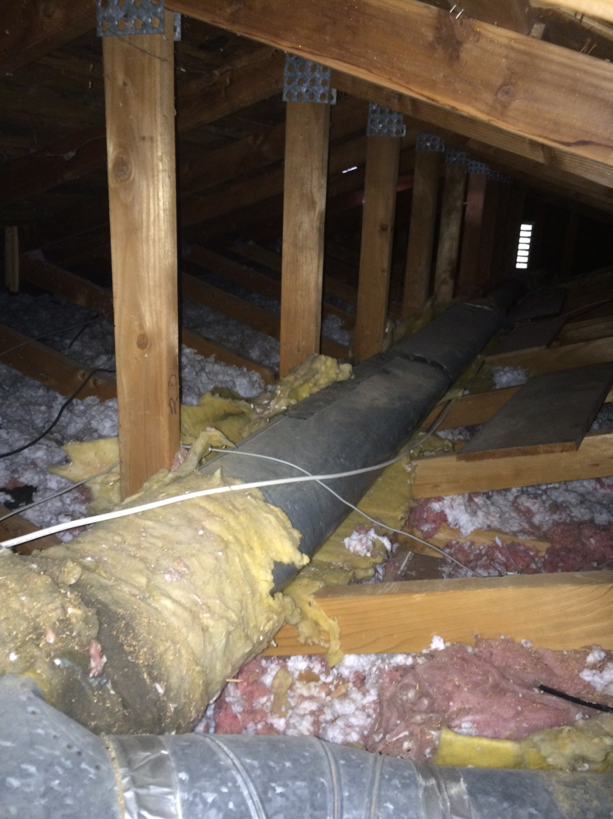

Slide 22
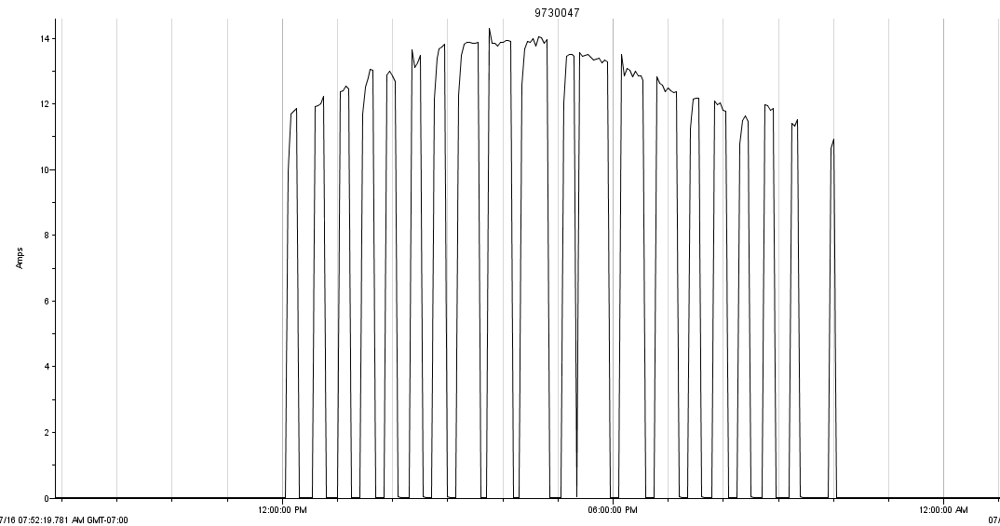
7/27- Hottest Day of 2016- 107 deg.

Slide 23
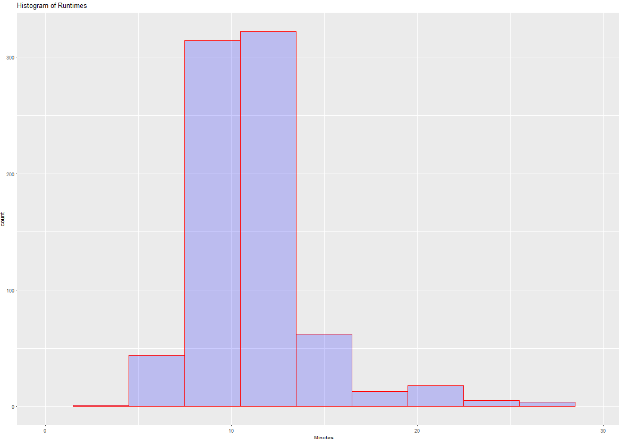
Average Runtime: 11.6 minutes
Longest Runtime: 63 minutes
Total Runtime of 154 hours
Energy Used:
Estimated Summer Cost:
# of cycles:
Total Runtime:

Slide 24
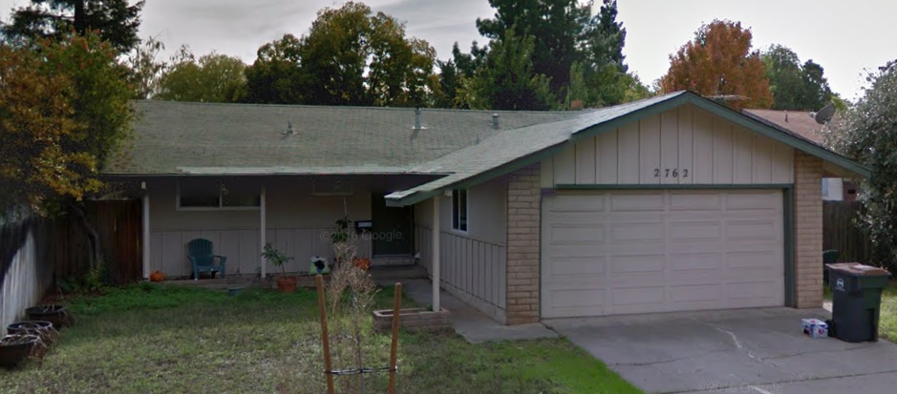
Leo Gonzalez

Slide 25
House Deets
2 ton XC16 w/ 45 kBTU FAU in mech closet
1220 SQFT (zillow), built 1971
Newer house, 102 CFM25 TDL, 1317 CFM50
Buried ductwork in attic
Dual pane windows with some shading
Monitored run times in 3 minute intervals from 6/21 – 9/27
Thermostat at 78 degrees, “on at 6”

Slide 26
